Slide 1


DISEASE PREDICTOR

Slide 2
PROBLEM STATEMENT
The purpose of the system is to provide prediction for the general and more commonly occurring disease that when unchecked can turn into fatal disease. This allows user to share their symptoms regarding their health. Here we use some data analysis techniques to predict whether a person is suffering from a disease or not.

Slide 3
Objective and work Distribution
The core objective of this project is to implement data mining techniques Decision Tree , Random Forest , Naïve Bayes , Support vector machine and KNN that classifies the disease as per the input of the user and to develop web interface platform for the prediction of the disease .This project aims to provide a web platform to predict the occurrences of disease on the basis of various symptoms. The user can select various symptoms and can find the diseases with their probabilistic figures.
Work Distribution:
Web Platform: Mahender Singh
Algorithms Implemented : Ankit Raj , Asheesh Mittal and Shubh Pandey

Slide 4
Design And Algorithm Implemented
1. Decision Tree
The decision tree approach is more powerful for classification problems. There are two steps in this technique building a tree & applying the tree to the dataset. Decision tree learning is one of the predictive modelling approaches used in statistics, data mining and machine learning. It uses a decision tree (as a predictive model) to go from observations about an item (represented in the branches) to conclusions about the item's target value (represented in the leaves). Tree models where the target variable can take a discrete set of values are called classification trees; in these tree structures, leaves represent class labels and branches represent conjunctions of features that lead to those class labels.
In decision analysis, a decision tree can be used to visually and explicitly represent decisions and decision making This technique gives maximum accuracy on training data. The overall concept is to build a tree that provides balance of flexibility & accuracy.

Slide 5
2. Random Forest
Random forest, like its name implies, consists of a large number of individual decision trees that operate as an ensemble . Each individual tree in the random forest spits out a class prediction and the class with the most votes becomes our model’s prediction. The fundamental concept behind random forest is a simple but powerful one — the wisdom of crowds. In data science speak, the reason that the random forest model works so well is:
A large number of relatively uncorrelated models (trees) operating as a committee will outperform any of the individual constituent models.
Random forest classifier creates a set of decision trees from randomly selected subset of training set. It then aggregates the votes from different decision trees to decide the final class of the test object.

Slide 6
3.Naive Bayes Classifier
The Naive Bayesian classifier is based on Bayes theorem with independence assumptions between predictors. A Naive Bayesian model is simple to build, with no difficult iterative parameter estimation which makes it particularly useful for very large datasets. Despite its simplicity, the Naive Bayesian classifier often does surprisingly well and is widely used because it often outperforms more sophisticated classification methods.
4.KNN
KNN is a basic lazy and nonparametric classifier. KNN is preferred when every one of the features are persistent. KNN is likewise called as case-based reasoning and has been utilized in numerous applications like statistical estimation, pattern recognition. Classification is distinguishing the closest neighbour to decide the class of an unknown sample. KNN is favoured over other classification algorithms due to its high merging velocity and straightforwardness. KNN characterization has two phases:
a) Find the k number of examples in the dataset that is nearest to instance S
b) These k number of examples at that point vote to decide the class of instance S

Slide 7
5.Support Vector Machine
The objective of the support vector machine algorithm is to find a hyperplane in an N-dimensional space (N — the number of features) that distinctly classifies the data points. To separate the two classes of data points, there are many possible hyperplanes that could be chosen. Our objective is to find a plane that has the maximum margin, i.e the maximum distance between data points of both classes. Maximizing the margin distance provides some reinforcement so that future data points can be classified with more confidence.
6.Stacking Classifier
Stacking is a method where a single training dataset is given to multiple models and trained. The training set is further divided using k-fold validation and the resultant model is formed. Here each model indicates a different algorithm used. In this we have used the combination svm,random forest and logstic regression. In this this have made an input table with the help of random forest and SVM algorithim then we have used this table as an input for logistic regression to predict the answer.

Slide 8
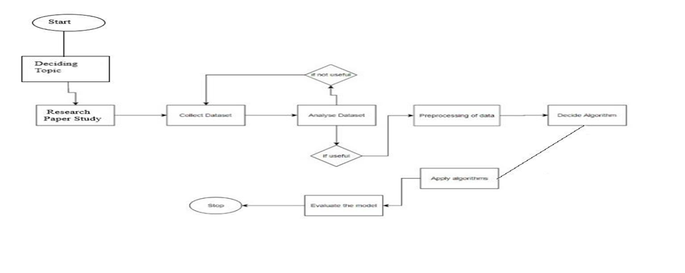
Project Pipeline

Slide 9
Result And Analysis
The prediction accuracy of the various Data mining techniques are:
1.Decision Tree: 81.7%
2.Random Forest: 98.5%
3.KNN: 92%
4.SVM: 96.5%
5.Naive Bayes: 97.5%
6.Stacking Classifier: 98.5%
As we can see that Random Forest and Stacking Classifier have the best accuracy for prediction but here we are using Random Forest Technique because of space complexity issue.

Slide 10
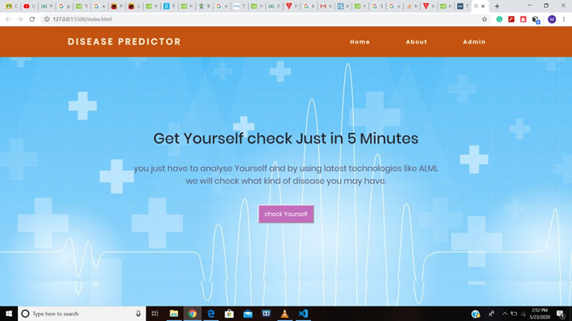
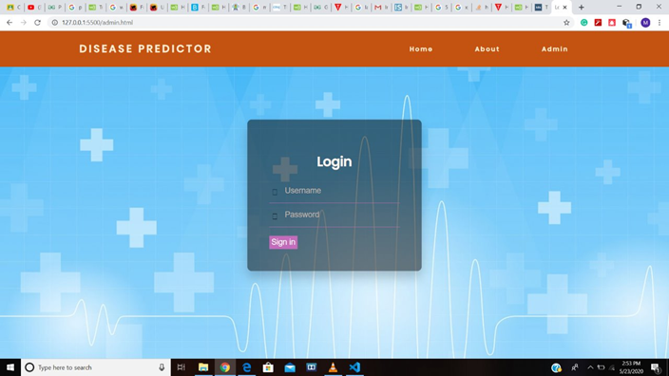
Results And Analysis
The test case designed for the project is discussed below:
Test case 1: Submit the symptoms from the list.
The symptoms are : abdominal pain, nausea ,high fever , fatigue, constipation, belly pain , toxic look, vomiting and chills.
Expected result: According to the symptoms submitted the expected disease is Typhoid.

Slide 11
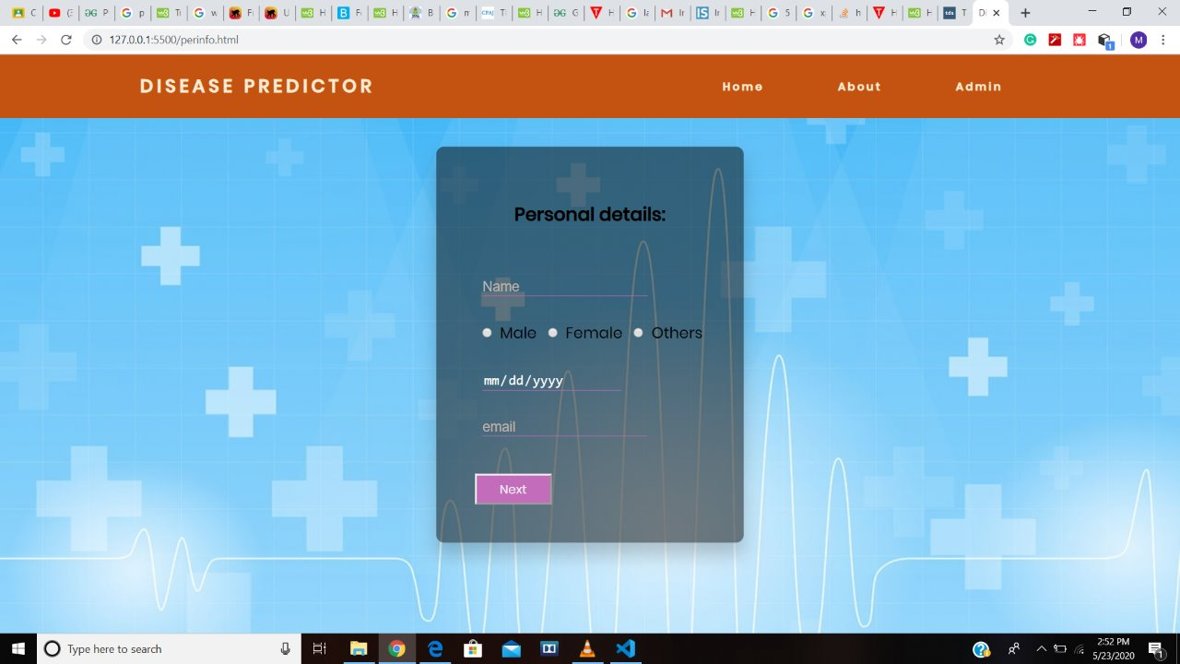
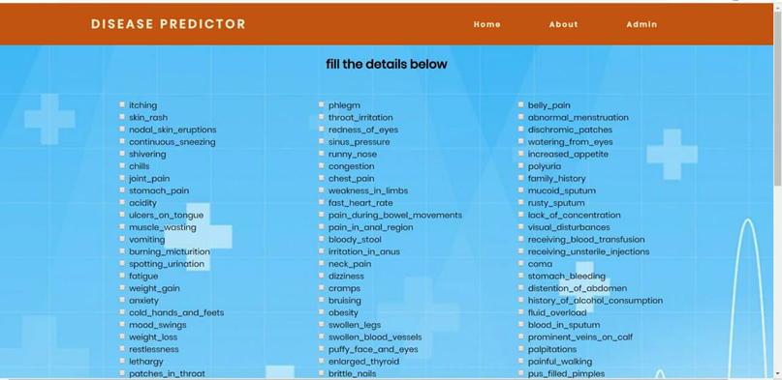
Test Case 2: Submit the symptoms from the list.
The symptoms are : Visual disturbances, depression, irritability , stiff neck, blurred vision, Acidity ,excessive hunger and headache.
Expected result: According to the symptoms submitted the expected disease is Migraine

Slide 12
Conclusion
The ultimate goal is to facilitate coordinated and well-informed health care systems capable of ensuring maximum patient satisfaction. In developing nations, predictive analytics are the next big idea in medicine –the next evolution in statistics – and roles will change as a result. Patients can get to become higher knowing and can get to assume a lot of responsibility for his or her own care, if they are to make use of the information derived. Physician roles can probably modification to a lot of an advisor than head, who will advise, warn and help individual patients. Perhaps time with individual patients can increase and physicians will another time have the time to create positive and lasting relationships with their patients. In this study five different data mining classification techniques were used for the prediction of various diseases and their performance was compared in order to evaluate the best classifier. An important challenge in data mining and machine learning areas is to build precise and computationally efficient classifiers for Medical applications

Slide 13
Future Scope
Every one of us would like to have a good medical care system and physicians are expected to be medical experts and take good decisions all the time. But it’s highly unlikely to memorize all the knowledge, patient history, records needed for every situation. Although they have all the massive amount of data and information; it’s difficult to compare and analyse the symptoms of all the diseases and predict the outcome. So, integrating information into patient’s personalized profile and performing an in-depth research is beyond the scope a physician. So the solution is ever heard of a personalized healthcare plan – exclusively crafted for an individual. Predictive analytics is the process to make predictions about the future by analyzing historical data. For health care, it would be convenient to make best decisions in case of every individual. Predictive modeling uses artificial intelligence to create a prediction from past records, trends, individuals, diseases and the model is deployed so that a new individual can get a prediction instantly. Health and Medicare units can use these predictive models to accurately assess when a patient can safely be released.

Slide 14
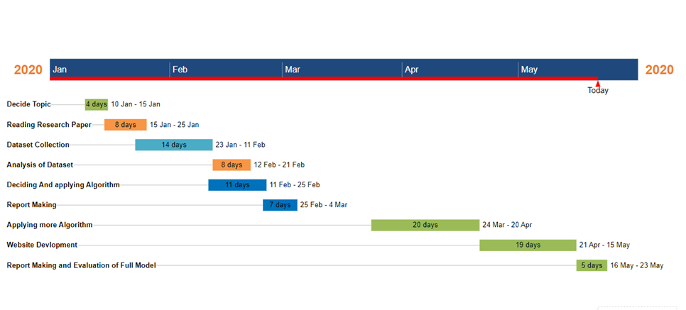
Gantt Chart

